Slide 1


GSORTING
SPRING 2023 CAPSTON PROJECT
PROF HENRY WANG
CONGYING ZHANG

Slide 2
AGENDA
01
02
03
04
Project Description
MVP
Technologies
Personas

Slide 3
AGENDA
05
06
07
08
Diagrams
Product
Backlog
Sprint 1
Backog
Metrics

Slide 4
AGENDA
09
10
11
To be continued（sprint 2）
Retrospective
Github
MVP Project Demo

Slide 5
01 Project Description

Slide 6
Project Description
“Gsorting” is a mobile application developed by Pace University students for CS 691 and CS 692 projects.
Primary goal- Identify waste types and give disposal recommendations
Feature Function- text search and photo scan search.
Better - Intuitive interface and user-friendly design, easier to use! Helps users stick with it easier!

Slide 7


02
MVP
Gsorting

Slide 8

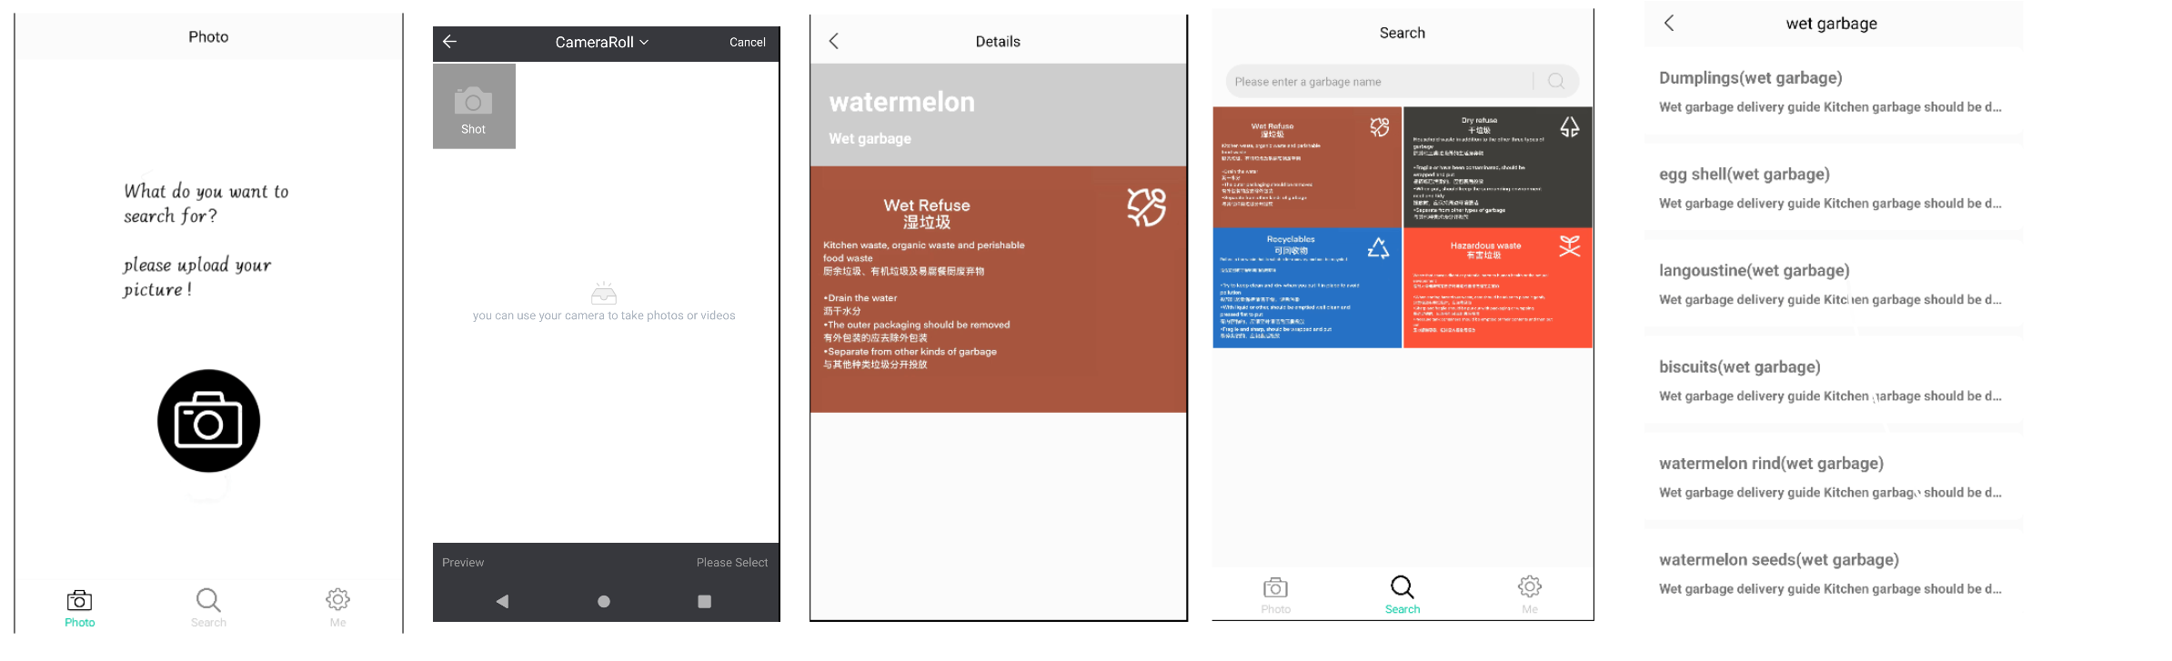
Minimal Viable Product

Slide 9

03
Technologies

Slide 10


Slide 11


04
Personas

Slide 12
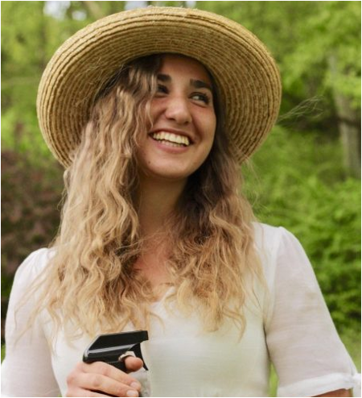
Persona 1-Eco-Conscious Edith Name: Edith Lucy Age: 30
Environmentally conscious homeowner: This person is environmentally conscious and actively seeks ways to reduce their household's carbon footprint. They may use the Gsorting app to identify and dispose of household waste in an environmentally friendly way.

Slide 13
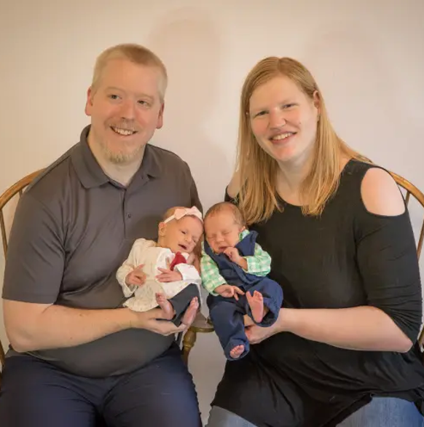
Persona 2 - Busy White Name: Mr. White & Mrs. White Age: 33 & 28 (Mr. White & Mrs. White)
Busy Parents: This persona is a pair of busy parents with limited time to do household chores. They can use the Gsorting app to identify the type of waste and get quick disposal advice to get rid of household waste quickly.

Slide 14
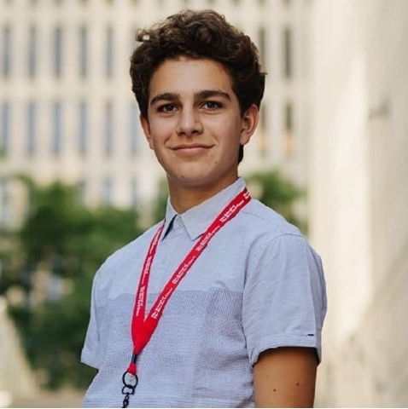
Persona 3-Student Sam Name: Sam Peter Age: 20
Student tenant: He's a college freshman. He may not be familiar with the waste management regulations of the city where the university is located and he can use the Gsorting app to properly sort his household waste and avoid fines.

Slide 15
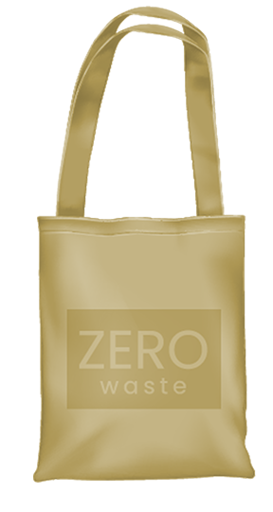
05
Architecture Diagrams

Slide 16
Architecture Diagrams
01
Conceptual Diagram
03
Class Diagram
02
Sequence Diagram
04
Use Case Diagram

Slide 17
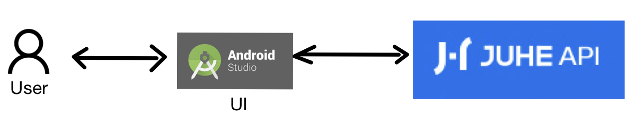
Conceptual Diagram

Slide 18
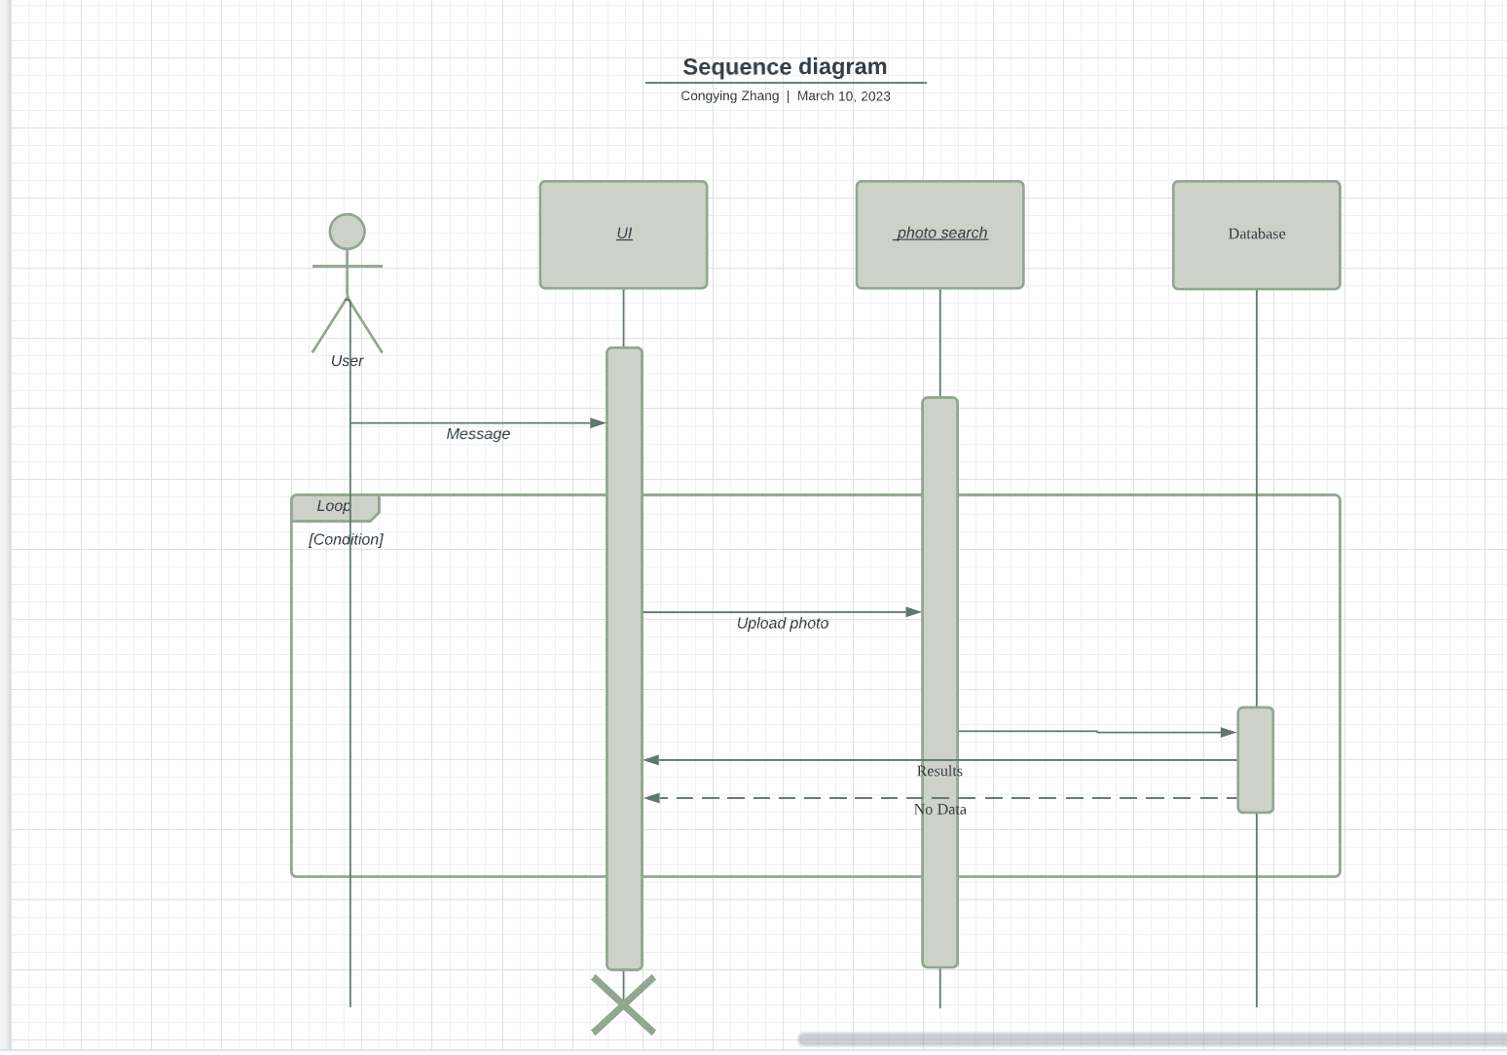
Sequence Diagram

Slide 19
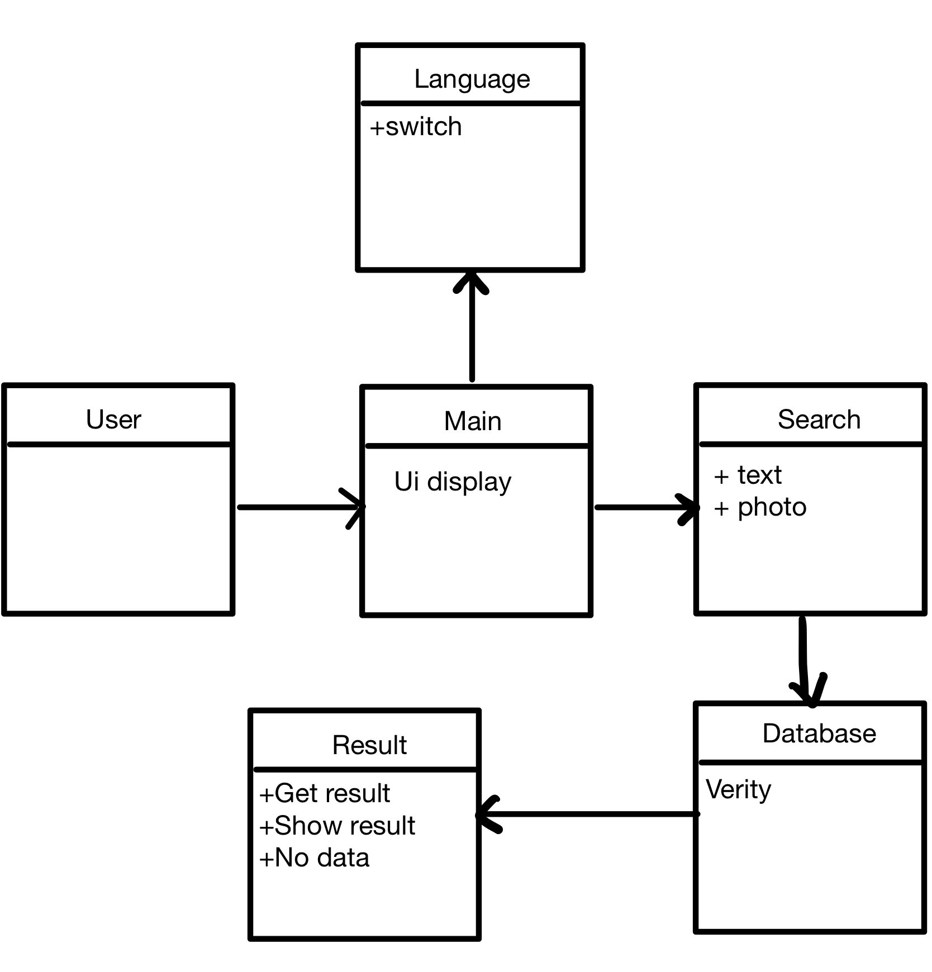
Class Diagram

Slide 20
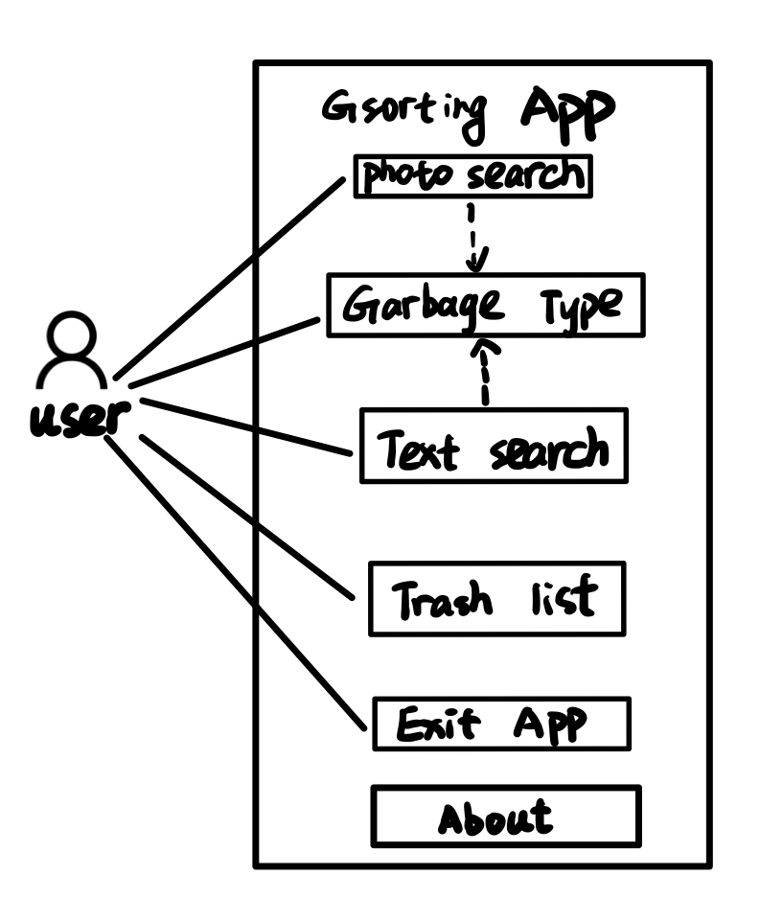
Use Case Diagram

Slide 21

06
Product Backlog

Slide 22
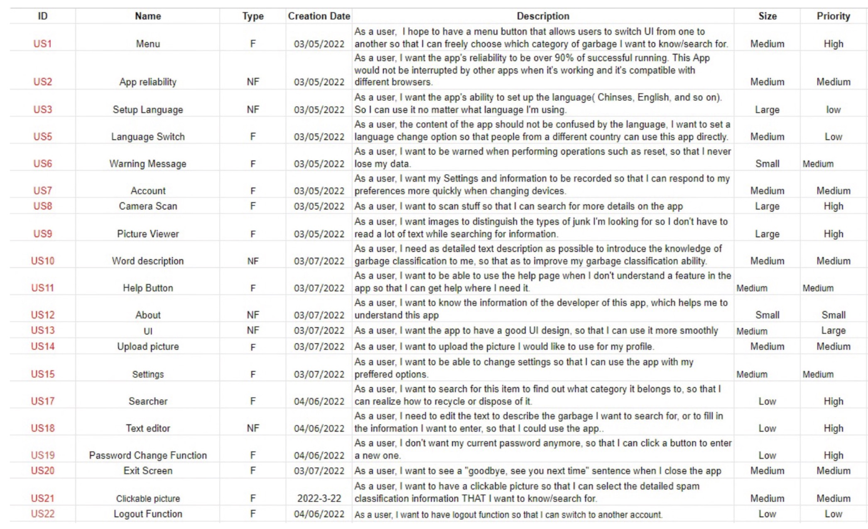

Slide 23
07
Sprint 1 Backog

Slide 24
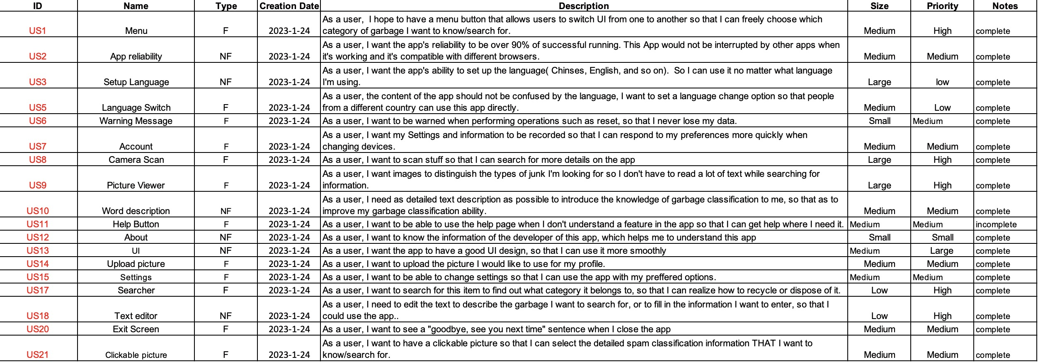

Slide 25

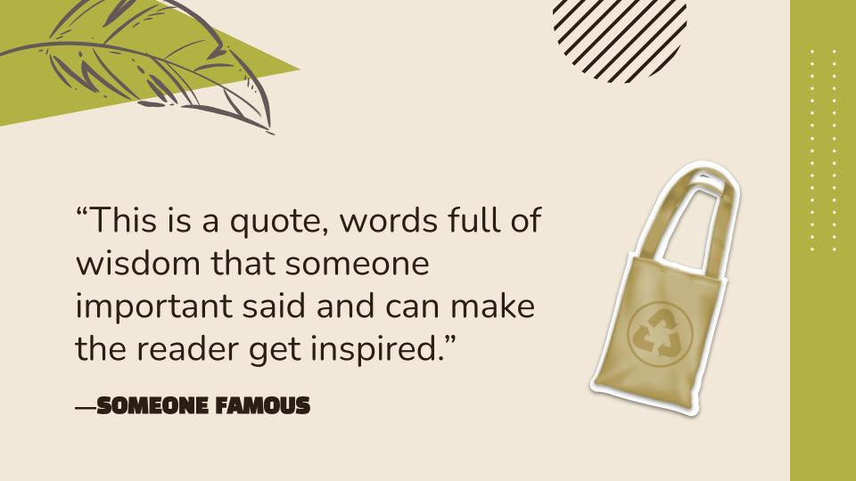
08
Metrics

Slide 26
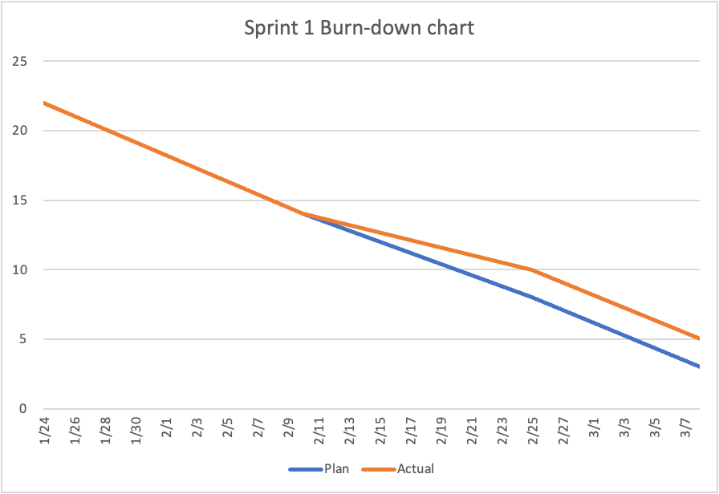
Team velocity and Burndown Charts
Sprint 1, I completed 17 user stories

Slide 27
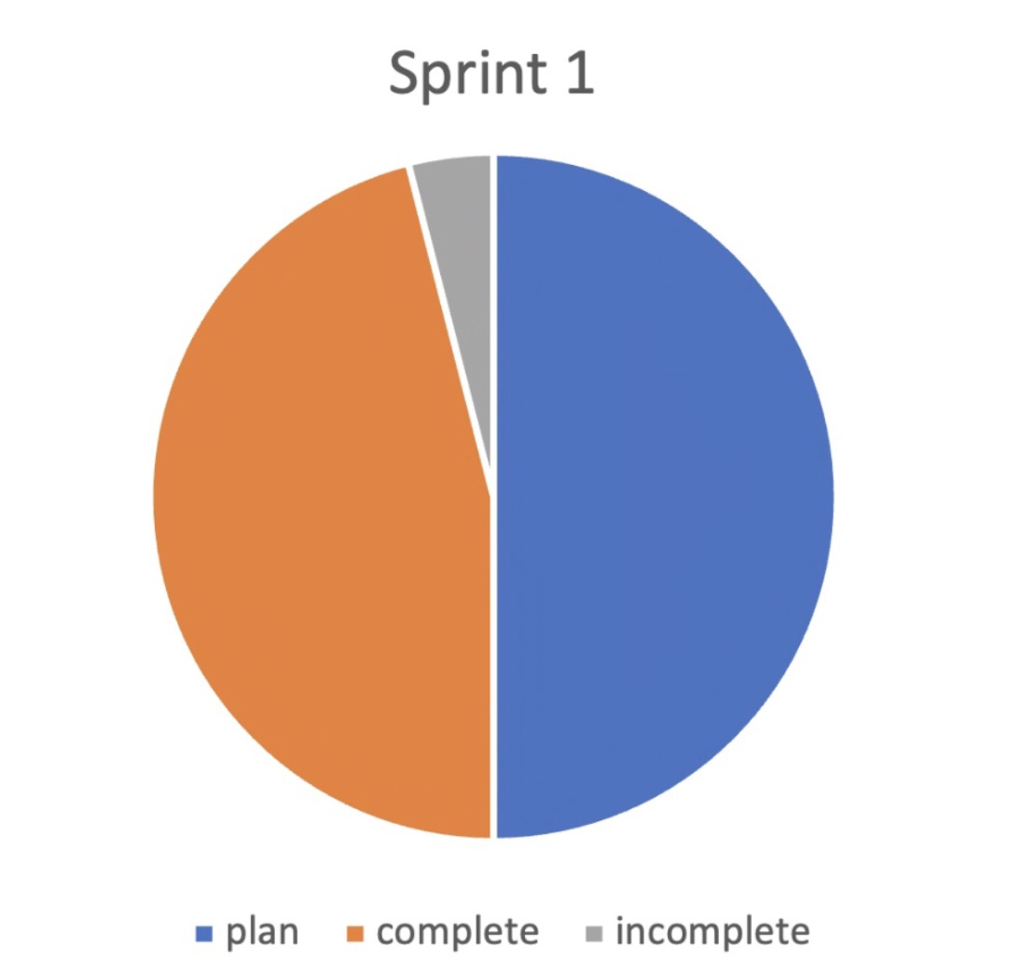
Completed/Committed Ratio
=17/19
=89.47%

Slide 28
09 Retrospective
Not good？
Better？
Next？
Improve？

Slide 29
Retrospective
What is going well？
01
What needs to be improved？
Gsorting's database accesses
UI design is easy to use
02
Not yet using machine learning
Haven't finished getting users to create accounts
What to do next？
03
Access to AWS for the app

Slide 30
10
GitHub
https://github.com/htmw/2023S-czhang

Slide 31
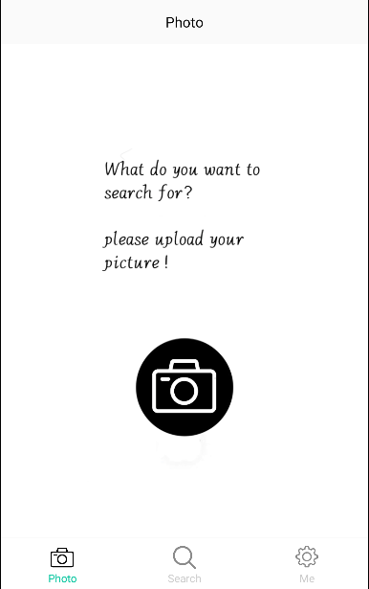
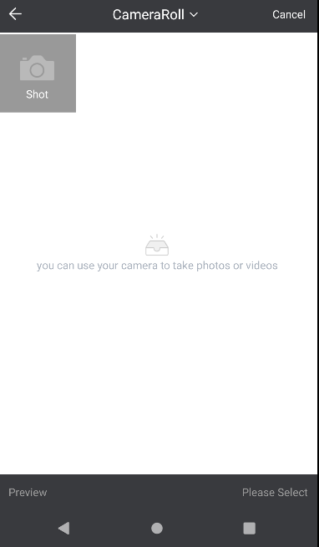
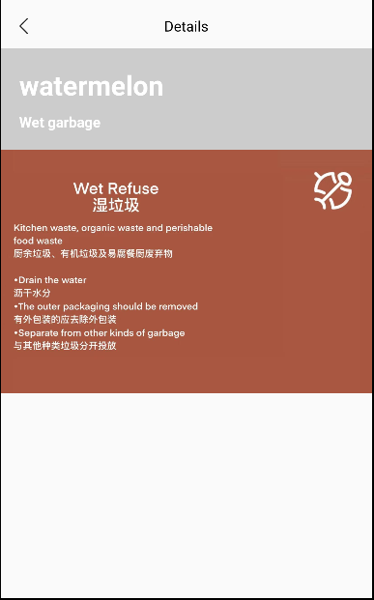
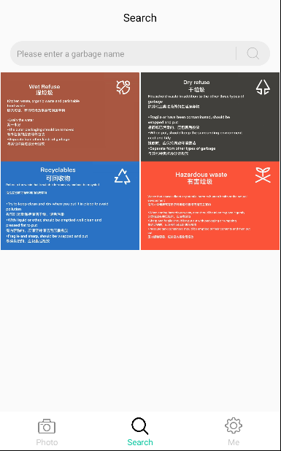
11. MVP Project Demo

Slide 32
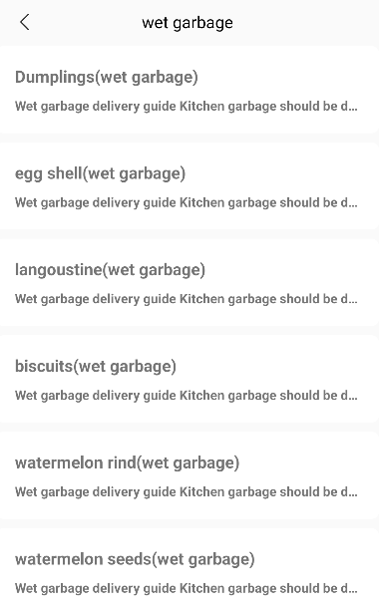
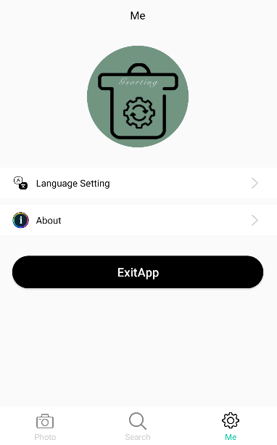
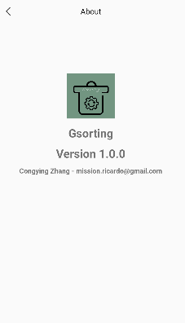
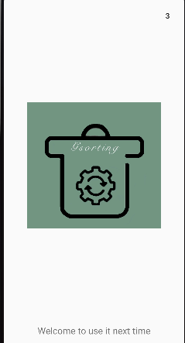
11. MVP Project Demo

Slide 33
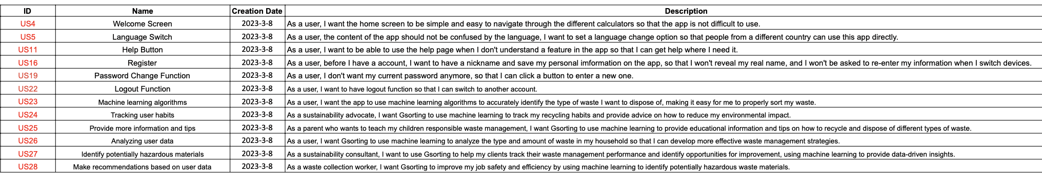
To be continued（Sprint 2）
Personas

Slide 34
Live Application Demo: https://youtube.com/shorts/v-zTi1481Ak?feature=share
Thanks

